Slide 1
Coding Guidelines and Best Practices
Author: Steven Villarosa

Slide 2


HTML and CSS Guidelines
Observe proper indentation.
.solid {
color: green;
font-weight: 700;
}
.solid
{
color: green;
font-weight: 700;
}

Slide 3
HTML and CSS Guidelines
Separate every css block with a single space.
Add a single space after the selector/s and before "{".
.solid {
color: green;
font-weight: 700;
}
.liquid {
color: red;
}

Slide 4
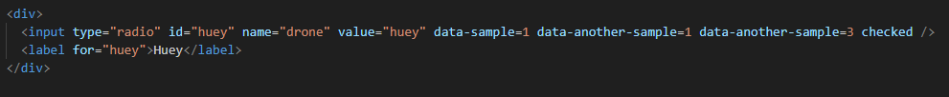
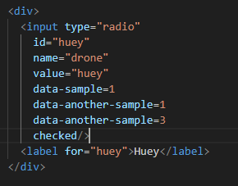
HTML and CSS Guidelines
There should be max of 80 col per line. Excess characters should be entered in a new line or attributes separated by new lines.
Very minor exceptions are allowed such as long URLs.

Slide 5
HTML and CSS Guidelines
Remove unnecessary comments.
Class names should be written in kebab case. All lower case separated by hyphen.
class=”save-button”
class=”cancel-button”
IDs should be written in snake case. All lower case separated by underscore.
id=”main_content”
id=”nav_item_one”

Slide 6
HTML and CSS Guidelines
Always do a mobile first approach when styling.
/* Mobile S */ @media (max-width: 320px) {...}
/* Mobile M */ @media (min-width: 321px) and (max-width: 375px) {...}
/* Mobile L */ @media (min-width: 376px) and (max-width: 425px) {...}
/* Tablet */ @media (min-width: 426px) and (max-width: 768px) {...}
/* Laptop */ @media (min-width: 769px) and (max-width: 1024px) {...}
/* & Above */ @media (min-width: 1025px) {...}

Slide 7
HTML and CSS Guidelines
In HTML, there should be no space before and after "=". Ex:
<div class="gallery">
In JS, there should be a space before and after "=". Ex:
let num = 6;
Do not use the <br> element. Apply proper styling instead.
Be consistent with your spacing. If you use 2 spaces instead of tabs, use 2 spaces all throughout your files. Discuss with your group so you follow the same spacing.

Slide 8
HTML and CSS Guidelines
For HTML attributes that are of boolean value, you can drop the value if you intend it to set to default.
<button
type="button"
disabled="true">
Comment
</button>
<button
type="button"
disabled>
Comment
</button>
<button
type="button"
disabled="false">
Comment
</button>
<button
type="button">
Comment
</button>

Slide 9
HTML and CSS Guidelines
Observe proper structuring of elements. You can nest the elements but you should not overlap them. In the sample below there are mistakes
a form is inside a p and it is closed outside the p.
p should only contain text and text elements such as strong and em
<p>
<form>
<h4>Name:</h4>
<input id="name">
…
</p>
<button id="comment_button"
type="button">Comment</button>
</form>

Slide 10


HTML and CSS Guidelines
When splitting element to multiple line of code, add at least double tab to the continuation line to indicate its a continuation and not a child element.
<button mat-raised-button class="edit-button"
(click)="editMusicItem(musicItem)">
<span>Edit</span>
</button>
<button mat-raised-button class="edit-button"
(click)="editMusicItem(musicItem)">
<span>Edit</span>
</button>
<button mat-raised-button class="edit-button"
(click)="editMusicItem(musicItem)">
<span>Edit</span>
</button>

Slide 11
HTML and CSS Guidelines
When splitting the elements into multiple lines, make sure that the continuation line is indented.
<form id="comment_form">
<label for="full_name">Full Name:</label>
<input type="text" id="full_name"
name="full_name">
<label for="comments">Comments:</label>
<textarea id="comments" name="comments"
rows="5" cols="55"></textarea>
</form>
<form id="comment_form">
<label for="full_name">Full Name:</label>
<input type="text" id="full_name"
name="full_name">
<label for="comments">Comments:</label>
<textarea id="comments" name="comments"
rows="5" cols="55"></textarea>
</form>

Slide 12
HTML and CSS Guidelines
Remove unnecessary breaking of lines. Place line breaks in proper places.
<img
class="image-gallery"
src="./images/landscape.jpg"
alt="Beautiful Landscape Image"
/>
<input
id="input_name"
type="text"
placeholder="Input your name"
oninput="validate()"
/>
<img
class="image-gallery"
src="./images/landscape.jpg"
alt="Beautiful Landscape Image"/>
<input
id="input_name"
type="text"
placeholder="Input your name"
oninput="validate()"/>

Slide 13
Javascript Guide
Always use "let" keyword in declaring variables over the "var" keyword.
Always use external Javascript.
Function names should be written in camel case.
Always terminate statements with ;
Do not modify styling in JS. Instead, simply add or remove classes in the DOM.
Separate every function block with a single space.
Use guard clause if possible to replace instead of if…else.

Slide 14
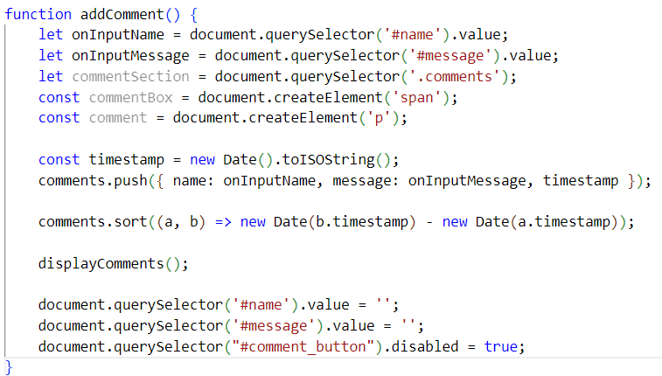
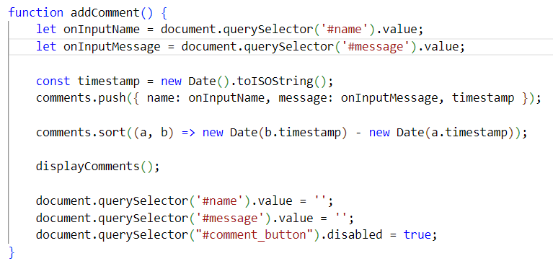
Javascript Guide
Remove console.logs() and unneccessary codes in the production environment.
Use console.error() for logging error messages.
Remove codes/variables that are not used.

Slide 15
Javascript Guide
Pass the function directly as an argument instead of calling it inside a function.
Remove unnecessary space between function name and ().
formId.addEventListener ("input", () => { enableButton (); });
formId.addEventListener("input", enableButton);

Slide 16
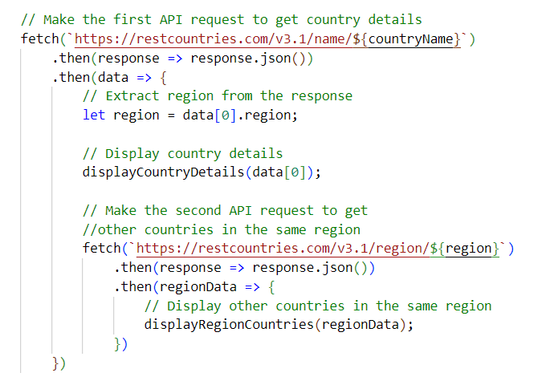
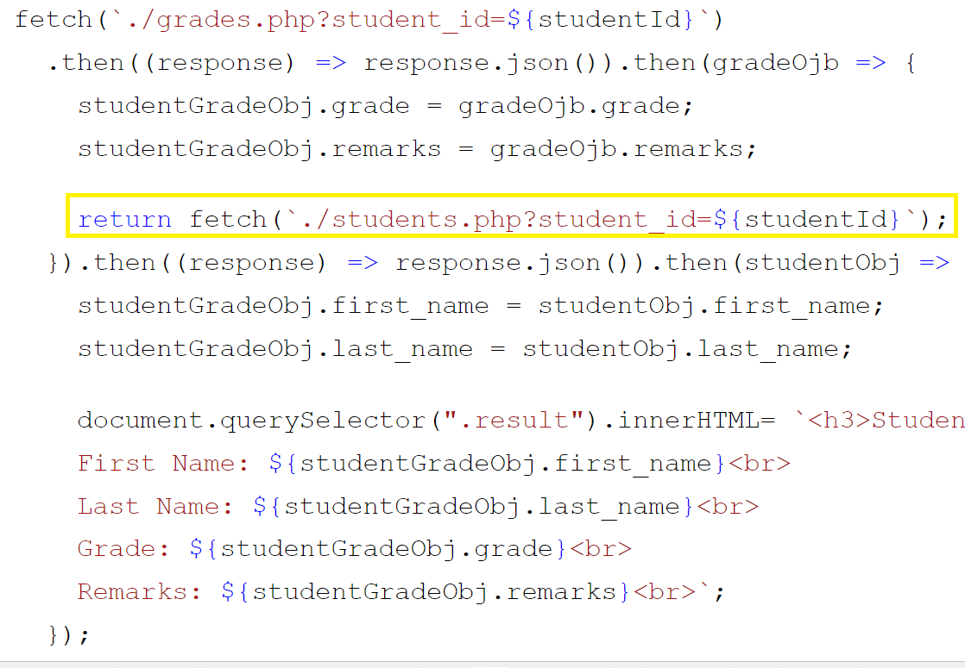
Javascript Guide
Do not create another fetch inside a then method. Instead, chain them by returning another fetch.

Slide 17
Javascript Guide
Since Javascript coerce the values, this means that the following code is unnecessary and should not be used:
=== undefined
=== null
=== true
=== false
=== 0
=== ""
if (msg === "") {
return 'String is empty';
}
if (!mgs) {
return 'String is empty';
}
if (isEven === true) {
return 'Even number';
}
if (isEven) {
return 'Even number';
}
if (number === 0) {
return 'it is zero';
}
if (!number) {
return 'it is zero';
}

Slide 18
Javascript Guide
Utilize JS coercion
Truthy and falsy values can be used to evaluate expression especially in conditionals
if (comments.length > 0 && name.length > 0) {
commentButton.disabled = false;
}
if (comments.length && name.length) {
commentButton.disabled = false;
}

Slide 19
Javascript Guide
Shorter is better, but more readable is best.
if (name.length && comment.length) {
commentButton.disabled = false;
} else {
commentButton.disabled = true;
}
commentButton.disabled = !(name.length && comment.length);

Slide 20
Javascript Guide
Always use the array literal method when creating arrays instead of new Array().
Use camel case for object property key.
The format for JS object property should be:
property_name: <value>
There should be no space after property_name
There should be a single space after colon.
Do not use arrow function as a method of an object.
Use dot notation in accessing object properties.
Avoid magic values, use constant values instead.
Use chaining as much as possible.
Design related attributes such as width and height should be set in CSS, not in HTML.

Slide 21
Javascript Guide
Format conditionals properly
if(nameInput.value.length && comment.value.length) {
document.getElementById("submit_button").disabled = false;
}
else {
document.getElementById("submit_button").disabled = true;
}
if(nameInput.value.length && comment.value.length) {
document.getElementById("submit_button").disabled = false;
} else {
document.getElementById("submit_button").disabled = true;
}

Slide 22
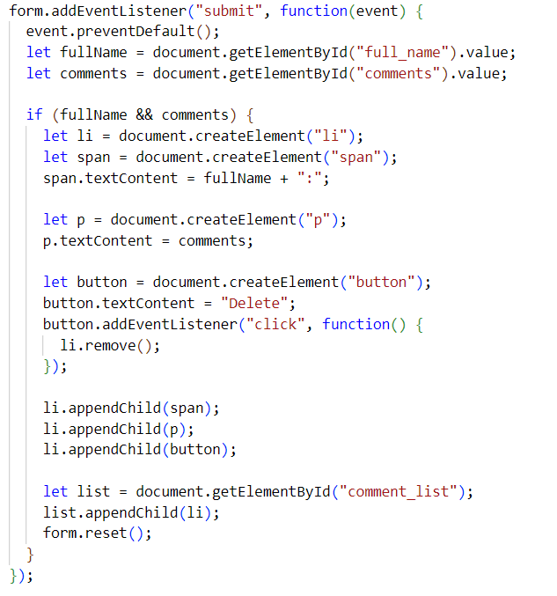
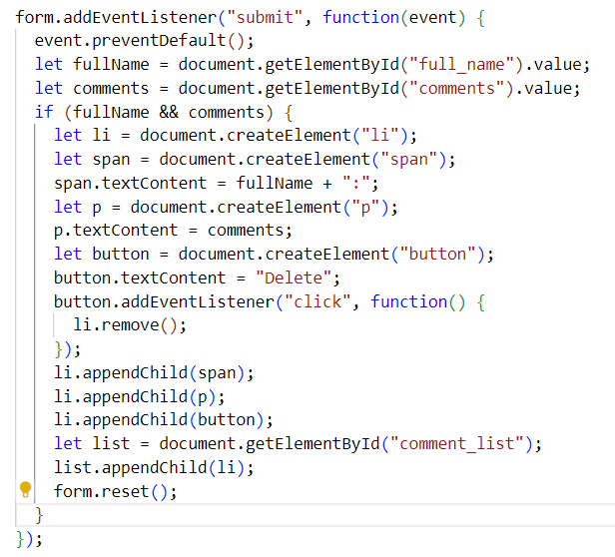
Javascript Guide
Consider adding line spaces between code and code groups for readability.

Slide 23
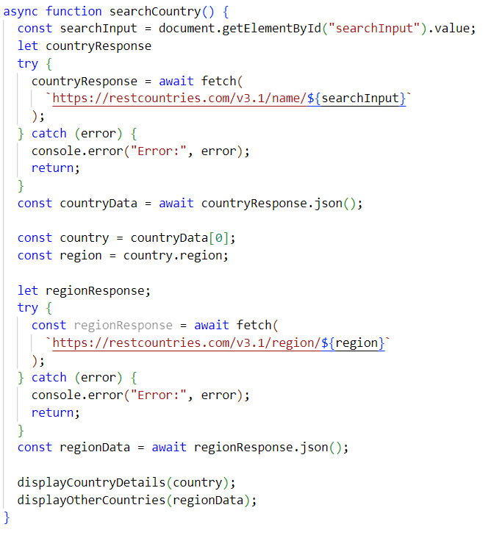
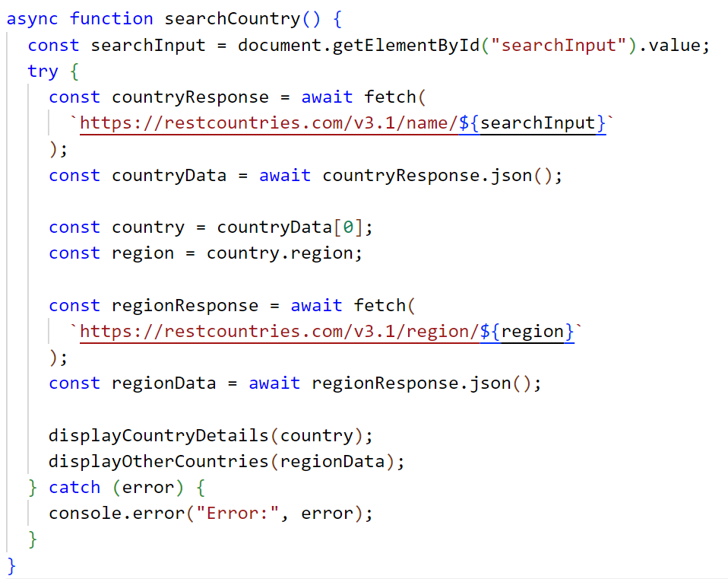
Javascript Guide
When you use try…catch statement, add only the statement that will throw an error. Mover other statements outside the try…catch block.
This may seem longer but a longer code is better than nested code. This will help you avoid adding a try…catch in another try…catch.

Slide 24
Javascript Guide
Refrain creating a named function inside another function.
Instead, move the function into a global scope and call it in the funtion.
document.addEventListener('DOMContentLoaded', function () {
...
function sortComments(order) {...}
...
function sortComments(order);
...
function getCurrentDate() {...}
...
function getCurrentDate();
});
document.addEventListener('DOMContentLoaded', function () {
...
sortComments(order);
getCurrentDate();
});
function sortComments(order) {...}
function getCurrentDate() {...}
Unnamed functions(function expressions and arrow functions) are exceptions.
startButton.addEventListener("click", function () {
timer = setInterval(function(){
console.log("Hello World!");
}, 3000);
} // function expression
function runTimer() {
setTimeout(()=> console.log("Hello!"), 5000);
}
// arrow function

Slide 25
General Guidelines
Remove unnecessary/excessive lines and spacing. Max of 1 extra new line for readability purpose.
All files should be named in snake case, all lower case.
Remove unnecessary files in the repo.
Use descriptive variable names: what they contain
Use descriptive function names: what they do
For boolean variables and functions, make the name answerable by yes or no. Ex. isValid, hasProperty, isOnline()

Slide 26
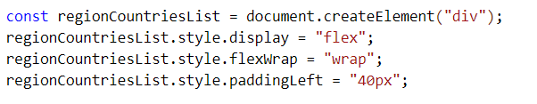
General Guidelines
CSS is for styling. Do not modify styles in JS. You can only add and remove classes in JS. The code below is not a good practice.
If you need to add something that needs to be done, add a TODO comment with the format:
<!-- TODO(Lastname, Givenname): What needs to be done --> - For HTML
// TODO(Lastname, Givenname): What needs to be done - For TS and JS

Slide 27
General Guidelines
Place all your assets into a common folder so it won't clutter your project directory.
/image or /asset
contains all the images
/js or /script
contains all the JS files
/style
contains all the CSS files
If you have one JS or CSS, you don't have to put in a separate directory. Simply put it in the same directory with your HTML file.
Remove dead and unnecessary codes and HTML elements.
Add space between ) and { in functions and code blocks.
if (confirmDelete){} → if (confirmDelete) {}

Slide 28
Why do we have to follow guidelines?
READABILITY!!!

